Slide 1
I-77 HOT Lanes Summary Statement

Slide 2
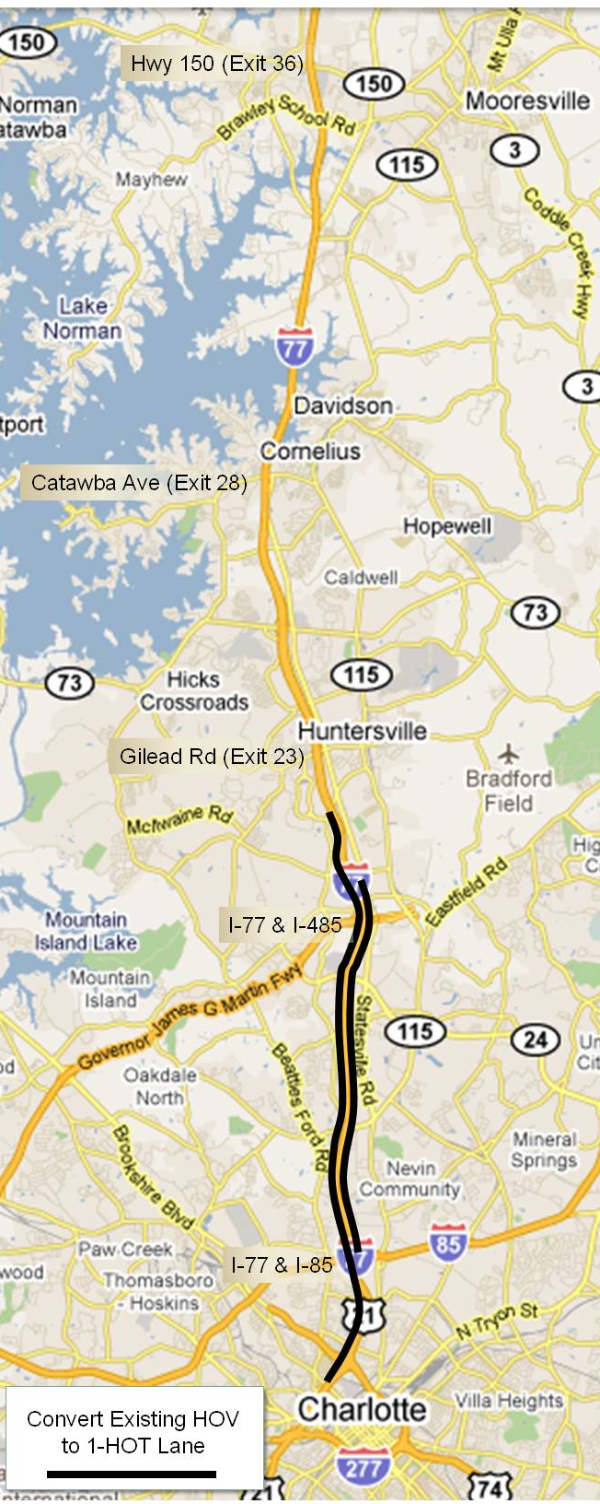
HOV Lanes Today

Slide 3
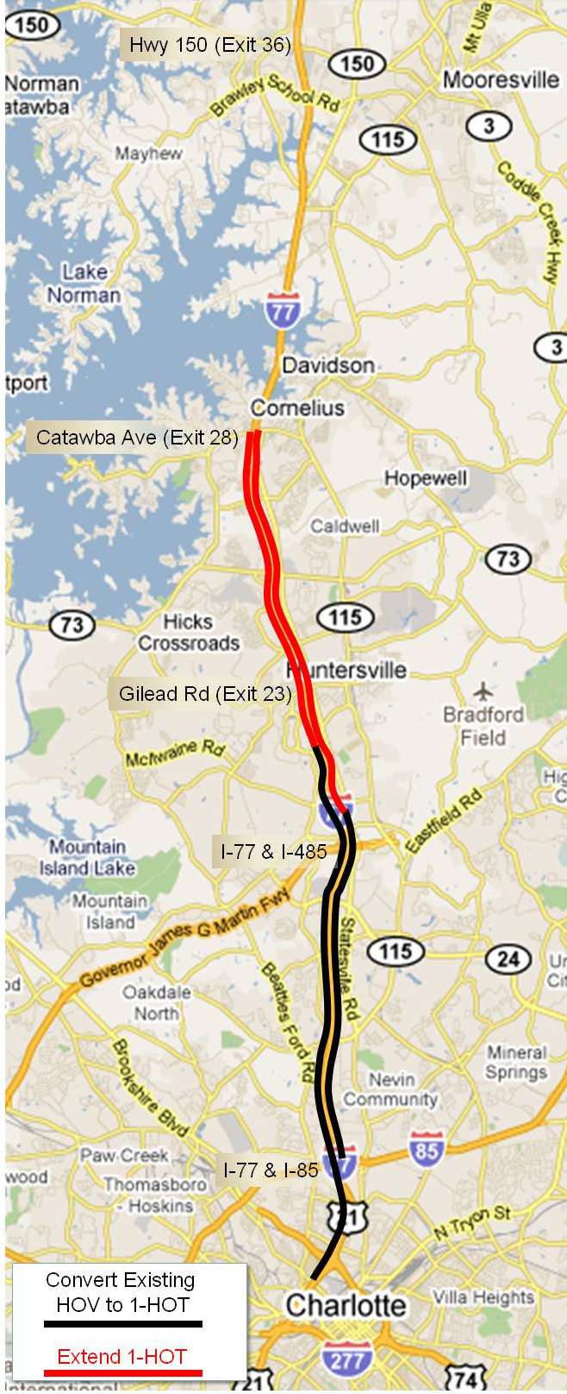
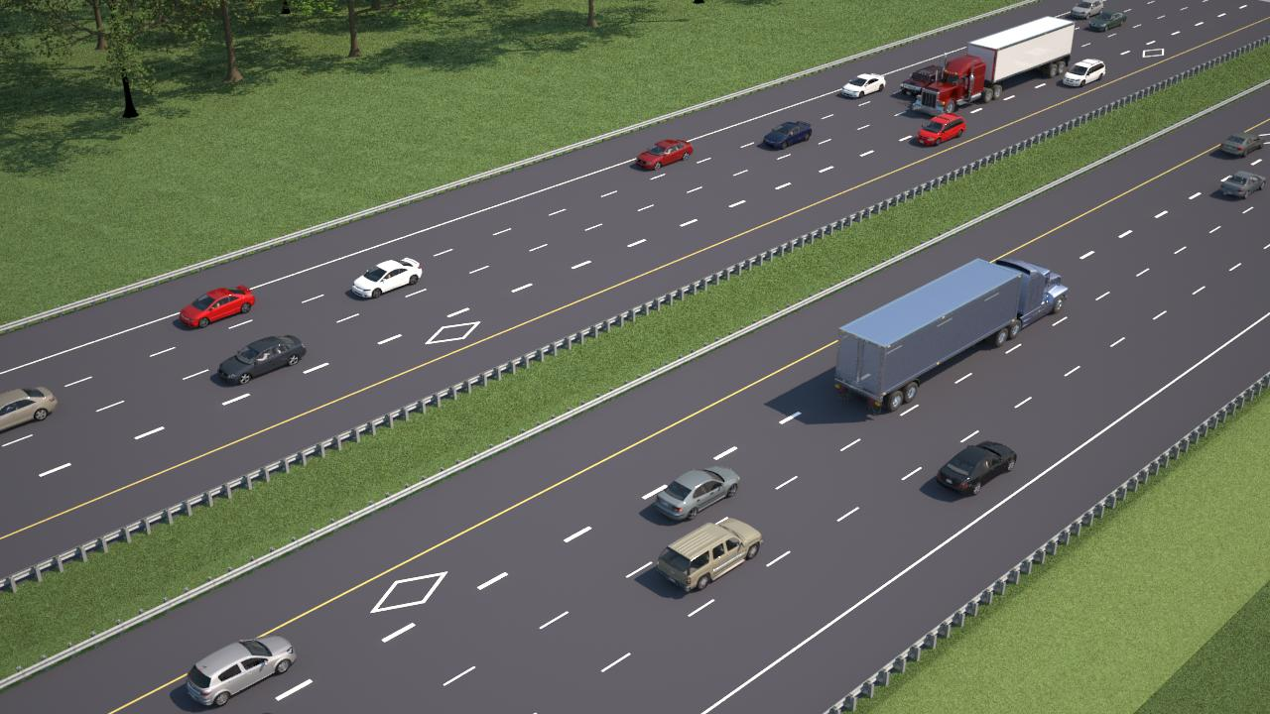
Proposed I-77 HOT Lanes: Scenarios 1 & 2
Scenario 1 contemplates one open road toll HOT lane in each direction with an HOV-2 designation
Scenario 2 contemplates one open road toll HOT lanes in each direction with an HOV-3 designation

Slide 4
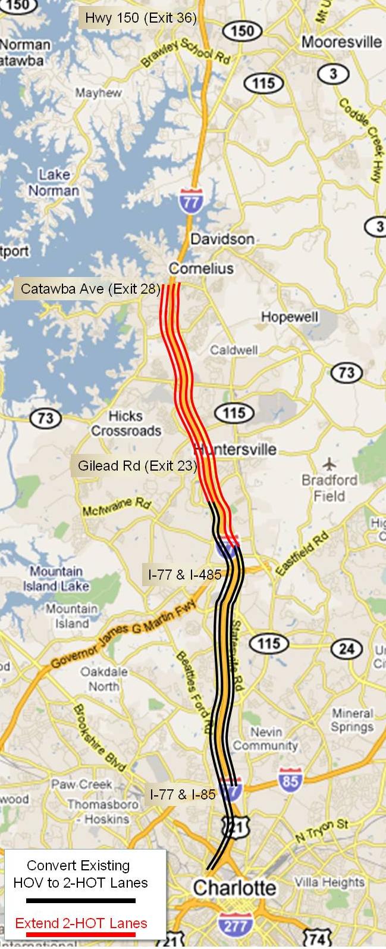
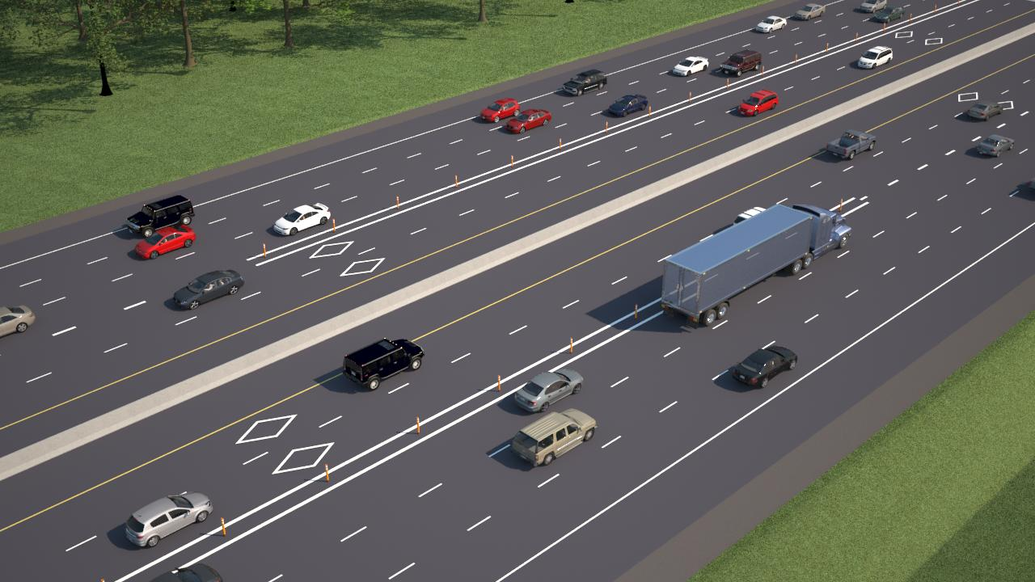
Proposed I-77 HOT Lanes: Scenarios 3 & 4
Scenario 3 contemplates two open road toll HOT lanes in each direction with an HOV-2 designation
Scenario 4 contemplates two open road toll HOT lanes in each direction with an HOV-3 designation

